Slide 1
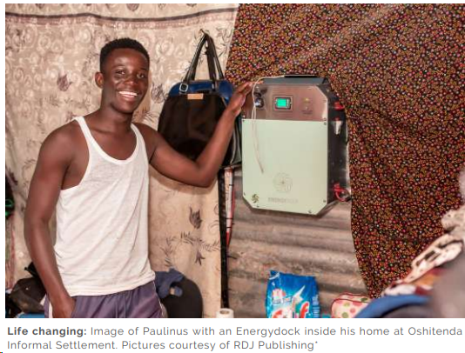

Slide 2
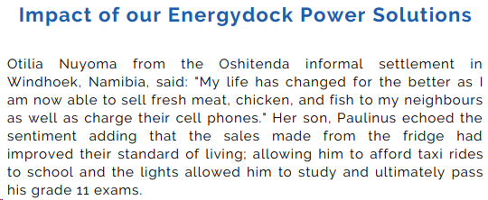
RURAL ELECTRIFICATION!

Slide 3
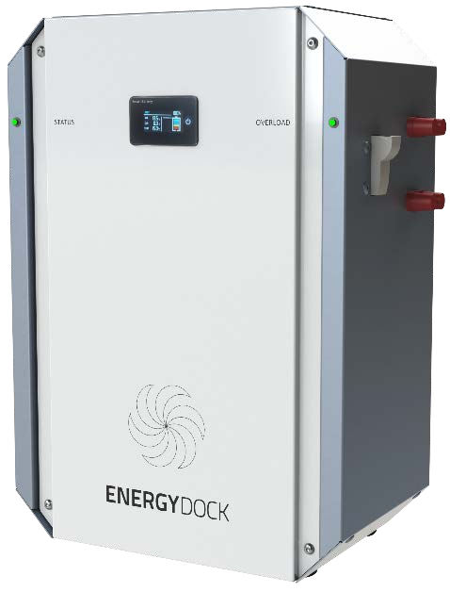
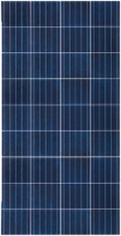

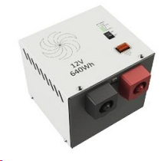

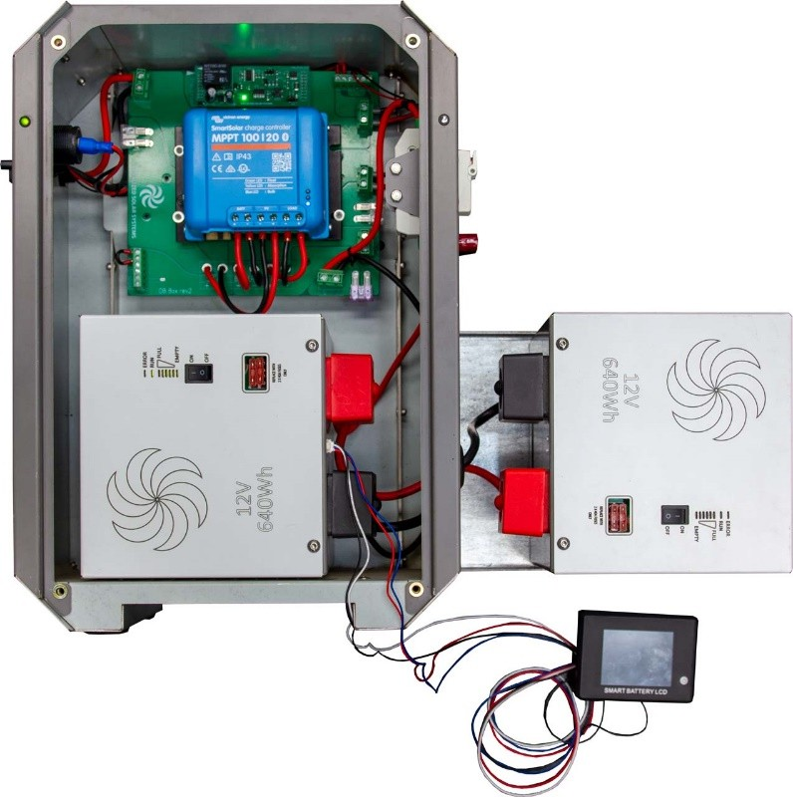
Solar Products
Picture | Description | Price
 | DC Energydock 0.640Wh The system can power: Cell Charging USB + Lighter point 5 X Internal Light Kits 1 X External Light Kit 1 X 32” TV (12v) 1 X Table Fan (12v) DSTV – System DSTV Ready Radio – System Radio Ready Appliances bought separately | N$ 12,500.00 VAT Inc Price includes: 150Wp Solar panel, PV cable set, 12V plug box, LifePO4 640Wh Battery
 | DC Energydock 640Wh + 640Wh The system can power: Cell Charging USB + Lighter point 6 X Internal Light Kits 2 X External Light Kit 1 X 32” TV (12v) 1 X Table Fan (12v) 1 X 12/24V Chest Freezer Appliances bought separately | N$ 29,500.00 VAT Inc Price includes: 150Wp Solar panel, PV cable set, 12V plug box, LifePO4 640Wh Battery plus additional 640Wh battery for freezer capability.

Slide 4


Picture | Description | Price
 | 12V Internal light kit | N$ 260.00
 | 12 External light kit | N$ 390.00

Slide 5

Picture | Description | Price
 | Universal charger | N$ 90.00
 | 2.5mm Male to Male | N$ 90.00

Slide 6
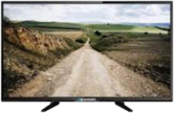
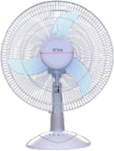
Picture | Description | Price
 | 12V 32-inch TV | N$ 4,700.00
 | 12V Fan | N$ 950.00

Slide 7
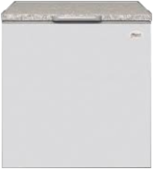
Picture | Description | Price
 | 12V Univa Freezer 210 L | N$ 8,200.00
 | 12V Univa Freezer 110 L | N$ 7,300.00

Slide 8
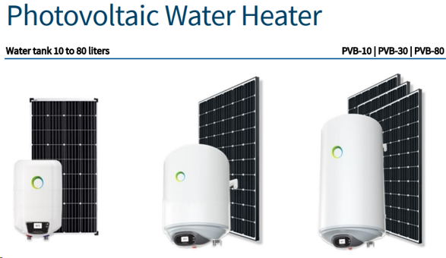
Photovoltaic 10L Water heater
Photovoltaic
30L Water heater
Photovoltaic 80L Water heater
N$ 9,000.00 Incl VAT
Includes PV Panel
N$ 14,700.00 Incl VAT
Includes PV Panels
N$ 20,300.00 Incl VAT
Includes PV Panels

